Slide 1
Bootstraping of RISC-V Microcontroller
Group Mentor:
Mr.arif Badar
Group Members:
1.Abhishek Pendse
2.Ankush Thakare
3.Archana Bidgar
4. Pallavi kharaje

Slide 2
What is RISC - V
RISC-V Introduction
We use RISC-V as a learning tool
A free and open ISA from Berkeley
A clean-slate design using what was learned over decades
Uncluttered by backwards compatibility
Simplicity-oriented (Some say to a fault!)
Many, many industry backers!
Google, Qualcomm, NVIDIA, IBM, Samsung, Huawei,

Slide 3
RISC-V Introduction
Composable, modular design
Consists of a base ISA -- RV32I (32 bit), RV64I (64 bit) (here we are using RV32I)
And many composable extensions. Including:
‘M’: Math extension. Multiply and divide
‘F’, ‘D’: Floating point extensions, single and double precision
‘A’: Atomic operations
‘B’: Bit manipulation
‘C’:Compressed instruction
‘I’ : intiger addition and substraction

Slide 4
what is c extention in risc microcontroller
In RISC-V microcontrollers, the C extension refers to the "Compressed Instruction Set" extension. It is an optional extension to the RISC-V architecture that introduces a set of 16-bit compressed instructions, in addition to the standard 32-bit instructions.
Key Points about the C Extension:
Reduced Code Size
Performance Impact
Compatibility
Instruction Set
Implementation

Slide 5
software used
QEMU
Freedom Studio
toolchain used - riscv-none-elf
board used : sparkfun red-v board
datasheet used :
1.redV board manual
2.SiFive FE310-G002 Manual

Slide 6
RISC-V base architecture components
Register file
Arithmetic Logic Unit
Main memory interface
Program Binary
…
Working data
…
Program
Counter
32-bit words*
x0 x1 x2 x3 x4 x5
Op
ALU
…
x31
Current location •
in program execution •
32 32-bit registers
(64 bit words for RV64)
Input: 2 values, Op
Output: 1 value
Actual memory outside CPU chip
Op ∈ {+, -, AND, OR, >, <, …}

Slide 7
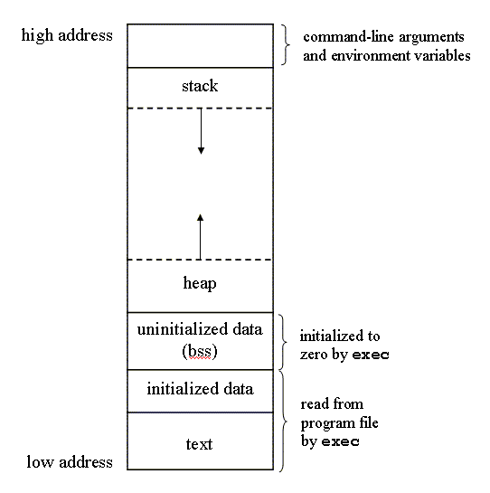
Memory layuout of programme

Slide 8
Pipeline in risc-v
A typical RISC-V pipeline consists of the following stages:
Fetch (IF): The instruction is fetched from memory.
Decode (ID): The fetched instruction is decoded to determine what action is required. During this stage, the instruction's operands are also fetched from the register file.
Execute (EX): The operation specified by the instruction is performed. This could be an arithmetic operation, address calculation for memory access, or branching decision.
Memory Access (MEM): If the instruction involves a load or store, the memory is accessed in this stage.
Write Back (WB): The result of the operation is written back to the register file.

Slide 9
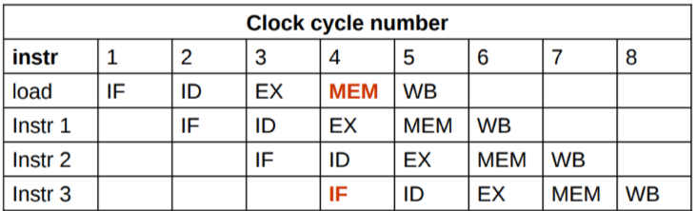
Multiple instruction run at a same time

Slide 10
Three types of instructions
Computational operation:
from register file to register file
Load/Store:
between memory and register file
Control flow:
jump to different part of code

Slide 11
Computational operations
Arithmetic, comparison, logical, shift operations
Register-register instructions
2 source operand registers
1 destination register
Format: op dst, src1, src2
Arithmetic | Comparison | Logical | Shift
add, sub | slt, sltu | and, or, xor | sll, srl, sra
set less than set less than unsigned
Signed/unsigned?
Shift left logical Shift right logical Shift right arithmetic
Arithmetic/logical?

Slide 12
Computational operations
Register-immediate operations
2 source operands
One register read
One immediate value encoded in the instruction
1 destination register
Format: op dst, src, imm
eg., addi x1, x2, 10
Format | Arithmetic | Comparison | Logical | Shift
register- register | add, sub | slt, sltu | and, or, xor | sll, srl, sra
register- immediate | addi | slti, sltiu | andi, ori, xori | slli, srli, srai
No “subi” instead use negative with “addi”

Slide 13
Load/Store operations
Format: op dst, offset(base)
Address specified by a pair of <base address, offset>
e.g., lw x1, 4(x2) # Load a word (4 bytes) from [x2]+4 to x1
The offset is a small constant
Variants for types
lw/sw: Word (4 bytes)
lh/lhu/sh: Half (2 bytes)
lb/lbu/sb: Byte (1 byte)
‘u’ variant is for unsigned loads
Half and Byte reads extends read data to 32 bits. Signed loads are sign-bit aware

Slide 14
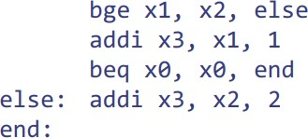

Control flow instructions - Branching
Format: cond src1, src2, label
If condition is met, jump to label. Otherwise, continue to next
beq | bne | blt | bge | bltu | bgeu
== | != | < | >= | < | >=
gcc
(Assume x1=a; x2=b; x3=c;)

Slide 15
Control flow instructions – Jump and Link
Format:
jal dst, label – Jump to ‘label’, store PC+4 in dst
jalr dst, offset(base) – Jump to rf[base]+offset, store PC+4 in dst
e.g., jalr x1, 4(x5) Jumps to x5+4, stores PC+4 in x1
Why do we need two variants?
jal has a limit on how far it can jump
(Why? Encoding issues explained later)
jalr used to jump to locations defined at runtime
Needed for many things including function calls
(e.g., Many callers calling one function)
…
jal x1, function1
…
function1:
…
jalr x0, 0(x1)

Slide 16
Load upper immediate instructions
LUI: Load upper immediate
lui dst, immediate → dst = immediate<<12
Can load (32-12 = 20) bits
Used to load large (~32 bits) immediate values to registers
lui followed by addi (load 12 bits) to load 32 bits
AUIPC: Add upper immediate to PC
auipc, dst, immediate → dst = PC + immediate<<12
Can load (32-12 = 20) bits
auipc followed by addi, then jalr to allow long jumps within any 32 bit address
Typically not used by human programmers!
Assemblers use them to implement complex operations

Slide 17
Pseudoinstructions
Using raw RISC-V instructions is complicated
e.g., How can I load a 32-bit immediate into a register?
Solved by “Pseudoinstructions” that are not implemented in hardware
Assembler expands it to one or more instructions
Pseudo-Instruction | Description
li dst, imm | Load immediate
la dst, label | Load label address
bgt, ble, bgtu, bleu, … | Branch conditions translated to hardware-implemented ones
jal label | jal x1, 0(label)
ret | Return from function (jalr x0, x1, 0)
…and more! Look at provided ISA reference
Why x0, why x1?

Slide 18
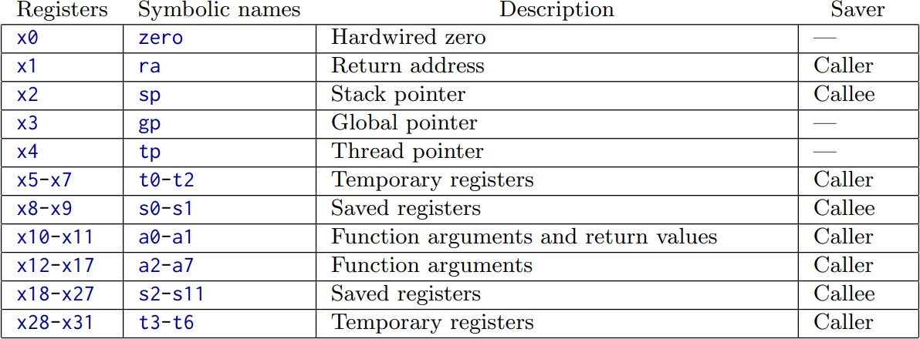
RISC-V register conventions
Convention: Not enforced by hardware, but agreed by programmers
Except x0 (zero). Value of x0 is always zero regardless of what you write to it
Used to discard operations results. e.g., jalr x0, x1, 0 ignores return address
?
Source: MIT 6.004 ISA Reference Card
Symbolic names also used in assembler syntax

Slide 19
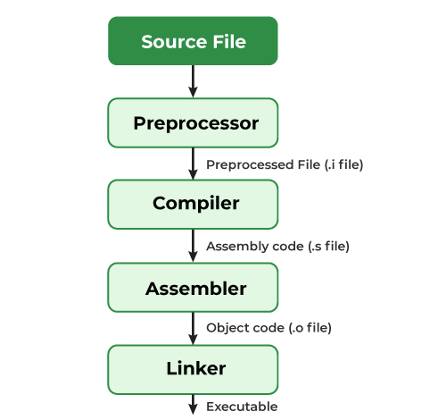
Compiling a C Program: Behind the Scenes

Slide 20
What goes inside the compilation process?
A compiler converts a C program into an executable. There are four phases for a C program to become an executable: 1.Pre-processing 2.Compilation 3.Assembly 4.Linking

Slide 21
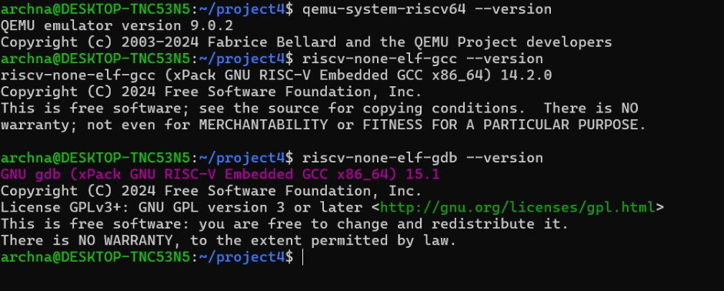
Qemu and risc-v Toolchain Installation

Slide 22
Inline assembly programming format
Format of inline assembly
Example
asm ( assembler template
: output operands (optional)
: input operands (optional)
: clobbered registers list (optional)
);
int a=10, b;
asm ("movl %1, %%eax;
movl %%eax, %0;"
:"=r"(b) /* output */
:"r"(a) /* input */
:"%eax" /* clobbered register */
);

Slide 23
GDB using for assembly language programming
why we use GDB
1.Step-by-Step Execution
2.Inspecting Registers and Memory
3.Setting Breakpoints
4.Analyzing the Stack
5.Debugging with Simulators
6.Disassembly
7.Watching Variables

Slide 24
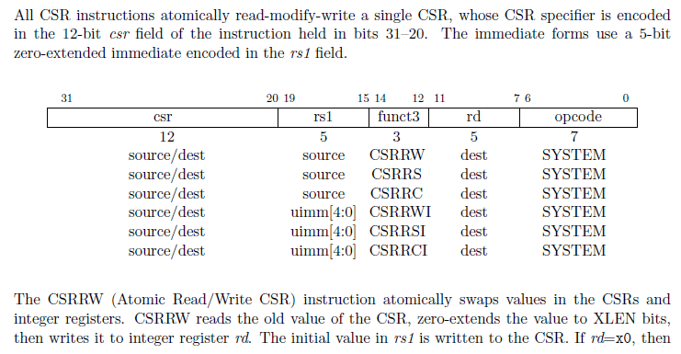
CSR instruction

Slide 25
CSRRW (Control and Status Register Read and Write)
CSRRS (Control and Status Register Read and Set)
CSRRC (Control and Status Register Read and Clear)
CSRRWI (Control and Status Register Read and Write Immediate)
CSRRSI (Control and Status Register Read and Set Immediate)
CSRRCI (Control and Status Register Read and Clear Immediate)

Slide 26
Commands used
objdump -d myprog.elf
file : for file format
make : for making elf object file

Slide 27
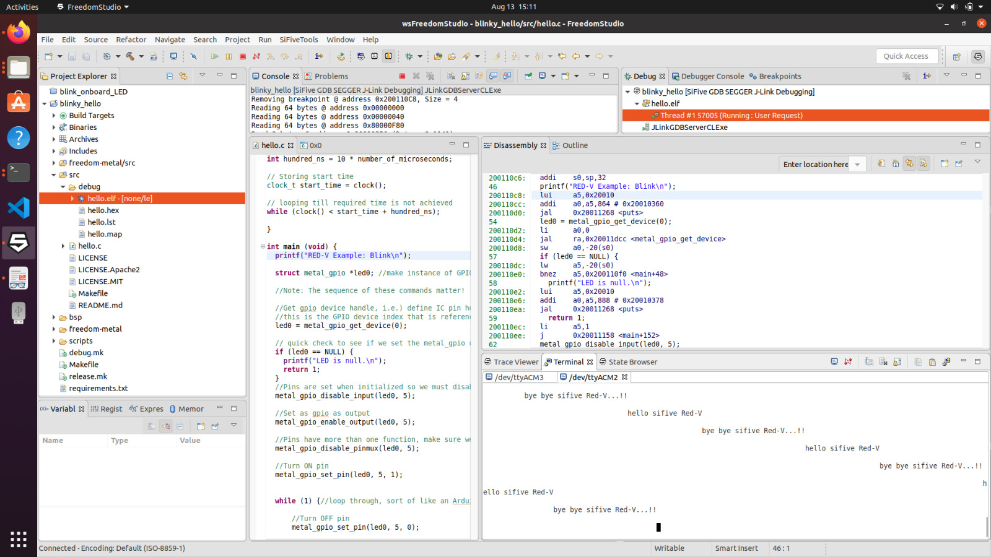
Freedom studio :

Slide 28
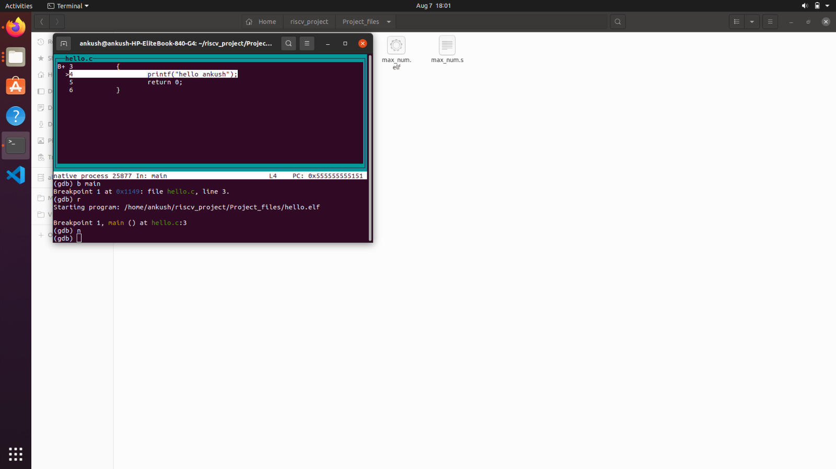
GDB screenshot

Slide 29
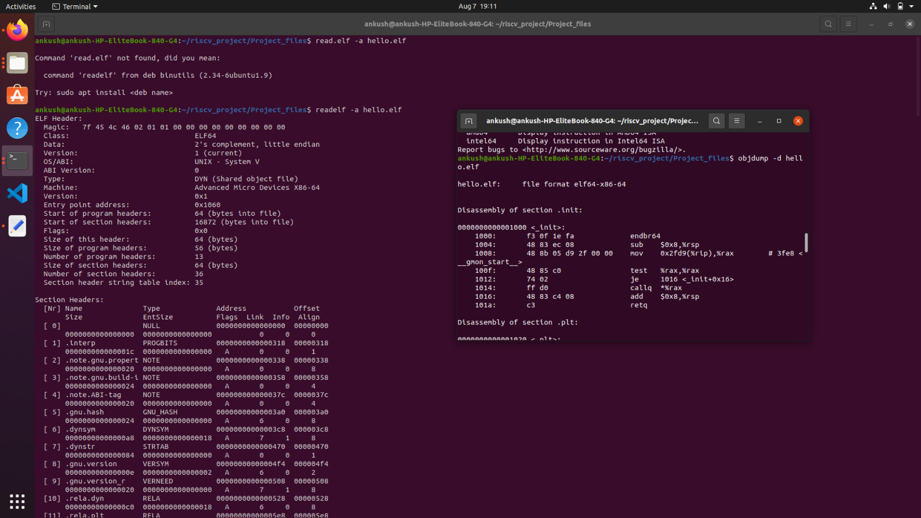
Readelf screenshot

Slide 30
Thank you.....

